Slide 1
Recovering our Common Sense: Psychology as an Observation Oriented Science
James W. Grice
Oklahoma State University
Department of Psychology
Presented at the 24th Annual Convention of the Association for Psychological Science. Chicago, IL, May27th, 2012. Symposium Title: Reforming Psychology’s Research Methods Curriculum, Brian Haig, Chair.

Slide 2
Something is still Wrong with Psychology
David Lykken (1991): What’s wrong with psychology, anyway?
Thinking clearly about psychology. Minneapolis: University of Minnesota Press.
Brad Woods (2011). What’s still wrong with psychology, anyway?
Unpublished Thesis, University of Canterbury, NZ. (“Probably the finest
Masters thesis I have ever read.” Paul Barrett, www.pbarrett.net)
From a 2012 article in Nature…
“…psychology has a number of deeply entrenched [problematic] cultural norms…It has become common practice, for example, to tweak experimental designs in ways that practically guarantee positive results. And once positive results are published, few researchers replicate the experiment exactly, instead carrying out ‘conceptual replications’ that test similar hypotheses using different methods. This practice, say critics, builds a house of cards on potentially shaky foundations.” [Yong, Ed (2012). Bad Copy. Nature, 485, 298-300]

Slide 3
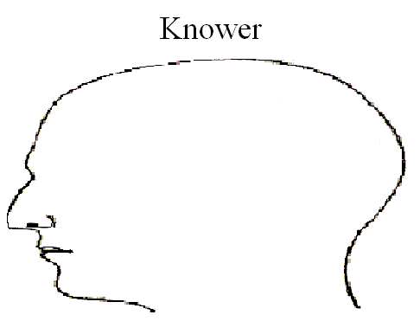
Cartesian Subjectivism
Things of the mind
Social Constructionism, Contextualism, Evolutionary, Humanistic, epistemologies (Rosenthal & Rosnow, 2008, Whitley, 1996)
Science is viewed largely as deductive (e.g., Popper’s falsification thesis; Hypothetico-Deductive model) and based on propositional logic (if A, then B; Observe ~B, etc.)
Science is characterized as uncertain and probabilistic knowledge

Slide 4
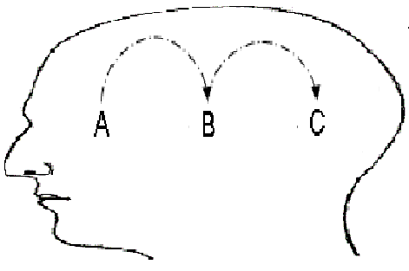
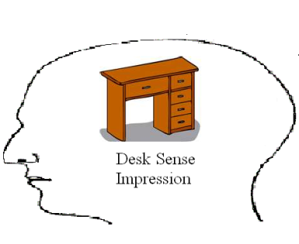
Cause in the Mind
Cause is understood through the work of J. S. Mill
e.g., Methods Agreement, Difference, & Concomitant Variation
Derived from Hume’s skeptical notion of cause
Empiricism with a subjective foundation
Scientific laws are regularities of sense impressions within the mind
A
?
B
?
C
?

Slide 5
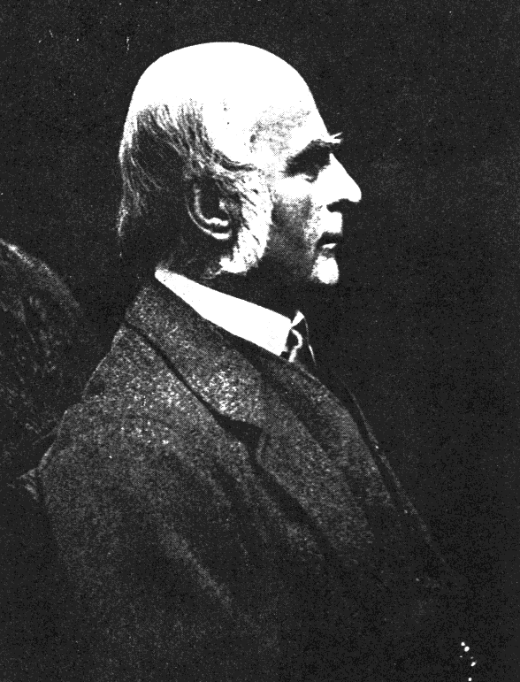
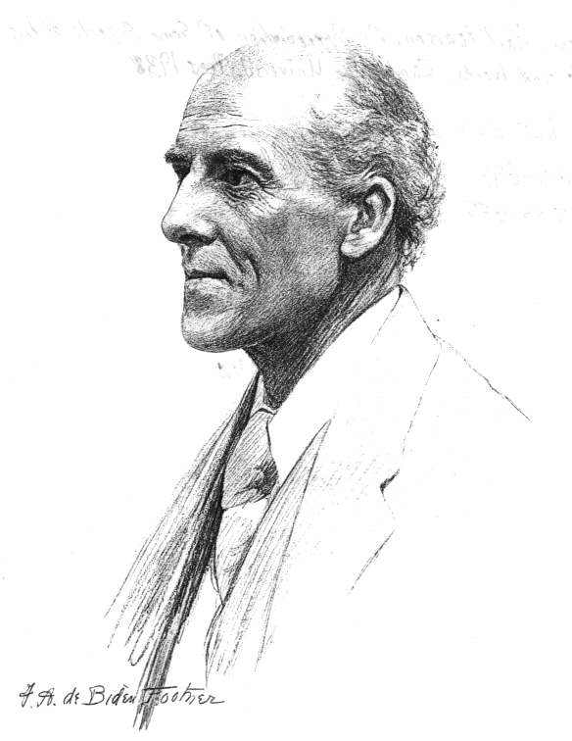
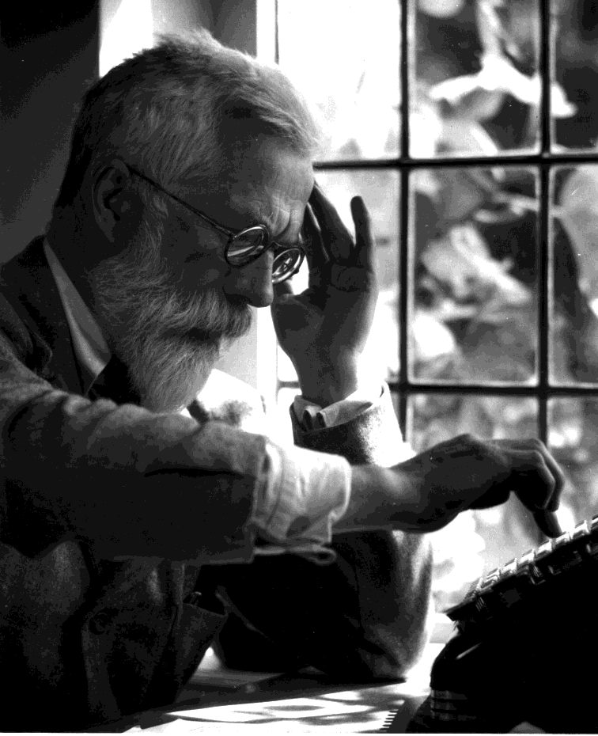
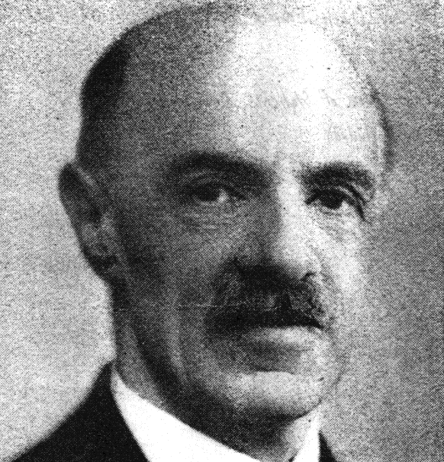
Subjectivism to Positivism
Francis Galton, Karl Pearson, Ronald Fisher, Charles Spearman (late 1800s – early 1900s)
Regression, correlation, ANOVA, factor analysis : very good for sorting sense impressions
Variable Models wedded to estimating population parameters and Null Hypothesis Significance Testing [NHST] (p < .05)

Slide 6
NHST is Incoherent
Gigerenzer, G. Mindless statistics. J. Socio-Econ. 2004, 33, 587-606.
Lambdin, C. Significance tests as sorcery: Science is empirical—significance tests are not. Theory & Psychology, 2011, 22(1) 67–90.
Upwards of 80% of surveyed psychology students, psychology professors, or statistics professors (!) showed basic misunderstandings of the meaning of a statistically significant result.
For example, “p ≤ .01 means that my study will replicate 99 out of 100 times.”

Slide 7
Variable Models and Population Parameters
A Study in Terror Management Theory
Norenzayan, A. & Hansen, I. (2006). Belief in Supernatural Agents in the face of death. Personality and Social Psychology Bulletin, 32, 174-187.
Thought of one’s death causes an increase in religiosity and an increase in theistic belief
Random assignment to one of two groups:
Write about favorite food
Write about personal death
“How strongly do you believe in God?”
Not at all 1 2 3 4 5 6 7 Very Strongly
|
Midpoint

Slide 8
Variable Models and Population Parameters
Assumption-laden NHST
Thought of
Death
t = 2.03*
Belief in
God
Assumptions
Random assignment (or sampling)
Normal population distributions
Homogeneity of population variances
Continuous dependent variable
Independence of observations
H_{o} is true
“p ≤ .05” is proper significance level
Goal is to estimate a population parameter; here, µ_{diff}, the difference between population means

Slide 9
Variable Models and Population Parameters
But, isn’t this a matter of cause and effect?
Mortality salience led to stronger religiosity, t(26) = 2.03, p = .05, and to a stronger belief in God, t(26) = 2.34, p = .03. These data offer initial experimental evidence that awareness of death motivates religiosity and, more specifically, belief in a higher power. (p. 176)
Mortality awareness increased religious identification, belief in God, and belief in the efficacy of divine intervention. (p. 183)
Why are we placing so much emphasis on the estimation of an abstract population parameter, µ_{diff}, when we really wish to speak of cause?
Can we really argue “led to” and “increased” without assessing participants over time?
Why no pretest of religiosity or belief?
Why no exact replication with four published studies?
Answers to these questions will NOT be forthcoming with current Modal Research Practice.

Slide 10
Variable Models and Population Parameters
Because of our positivistic philosophy and methods…
We don’t see causes as inhering in the people themselves.
We take the aggregate statistic (here mean_{diff}) to be more “real” than any existing participant.
We ignore foundational questions of measurement because we never have to address the nature of belief in God, for instance, as an existing quality.
Philosophical realism and Observation Oriented Modeling,
I hope, provide a way forward.

Slide 11
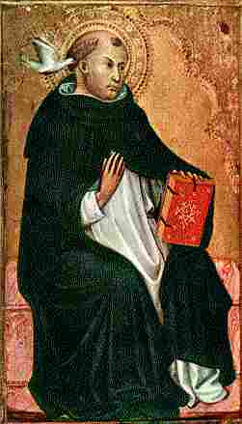
Observation Oriented Modeling
Causality construed analogously as Order and Conformity
…for the human act terminates at that which the will intends as the end; thus in natural agents the form of the thing generated is conformed to the form of the generator. Summa, I, II, Q 1, a3
In other words, the effect conforms to the cause
How are the observations ordered and do they conform to one another as expected?
How strongly do you believe in God?
A. Not at all 1 2 3 4 5 6 7 Very Strongly
|
Midpoint
B Food / Death

Slide 12
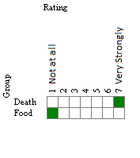
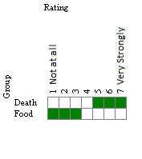
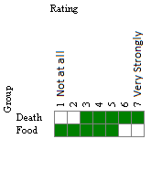
Observation Oriented Modeling
What is the expected pattern?

Slide 13
Variable Models and Population Parameters
Thought of
Death
Belief in
God

Slide 14
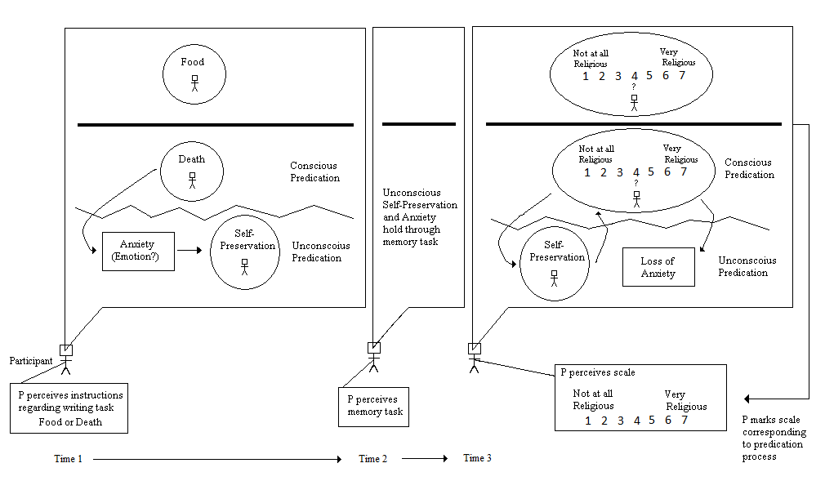
Integrated Model

Slide 15
Variable Models and Population Parameters
Thought of
Death
Belief in
God

Slide 16
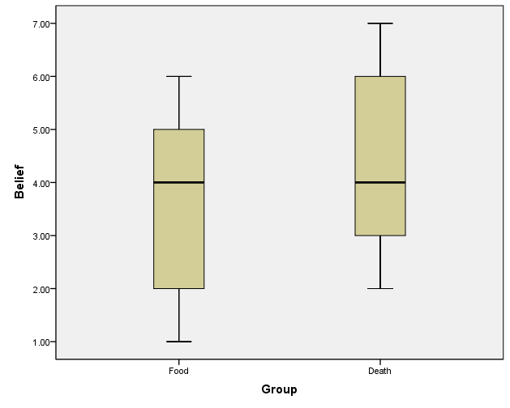
Variable Models and Population Parameters
Hypotheses: H_{o} : μ_{Food} = μ_{Death}; H_{A} : μ_{Food} > μ_{Death} or μ_{Food} < μ_{Death}
M_{Death} = 4.40 (SD = 1.64), M_{Food} = 3.48 (SD = 1.92), t(64) = 2.07, p = .043, d = .51 (medium effect using Cohen’s conventions)

Slide 17
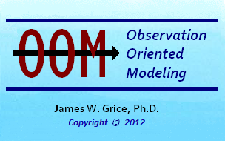
Observation Oriented Modeling
Specific Pattern Matching

Slide 18
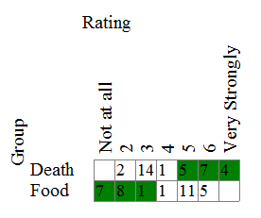
Aggregates vs. Persons
Hypotheses: H_{o} : μ_{Food} = μ_{Death}; H_{A} : μ_{Food} > μ_{Death} or μ_{Food} < μ_{Death}
M_{Death} = 4.40 (SD = 1.64), M_{Food} = 3.48 (SD = 1.92), t(64) = 2.07, p = .043, d = .51 (medium effect using Cohen’s conventions)

Slide 19
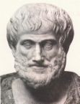
Scientia Naturalis
Natural science (epistēmē) is demonstrable knowledge of nature through its causes: Formal, Material, Efficient, and Final
Causes are not found in estimated population parameters but within persons
Qualities must not be assumed to be structured as continuous quantities
Think schematically whenever possible
Demotion of Null Hypothesis Significance Testing (NHST)
Results and effect magnitudes must be transparent and meaningful
Replication trumps single probability values

Slide 20
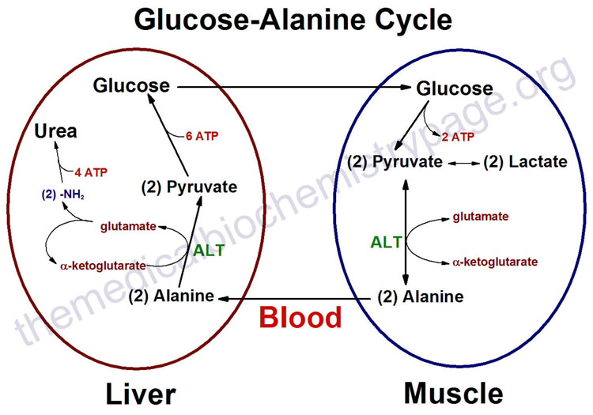
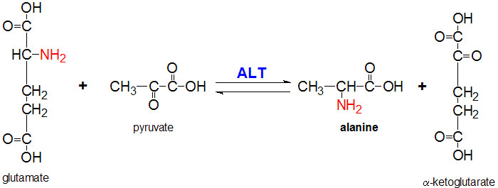
Biochemical Models
www.themedicalbiochemistrypage.org

Slide 21
Integrated Model

Slide 22
The End

